Slide 1
Leisure time, Culture
Tourists information and consultation services are provided by budgetary organization Rokiškis Information and Coordination Center of Tourism and Traditional Crafts. The center is set in Rokiskis Independence square 8. For more detailed information please visit website http://www.rokiskiotic.lt/lt/apie-mus or contact:
Phone.:+370 458 510 44,
Email: info@rokiskiotic.lt

Slide 2
Tourism attraction is Rokiškis Region Museum, located in the former mansion of Tyzenhaus, which includes 16 extant buildings, as well as a park (28.1 ha) with ponds, 80 thousand exhibits. Detailed information about museum could be found in website: http://www.muziejusrokiskyje.lt/en/

Slide 3
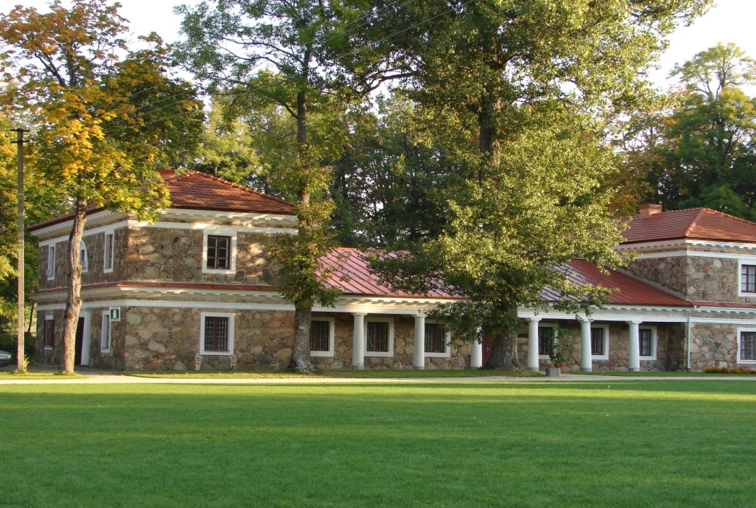
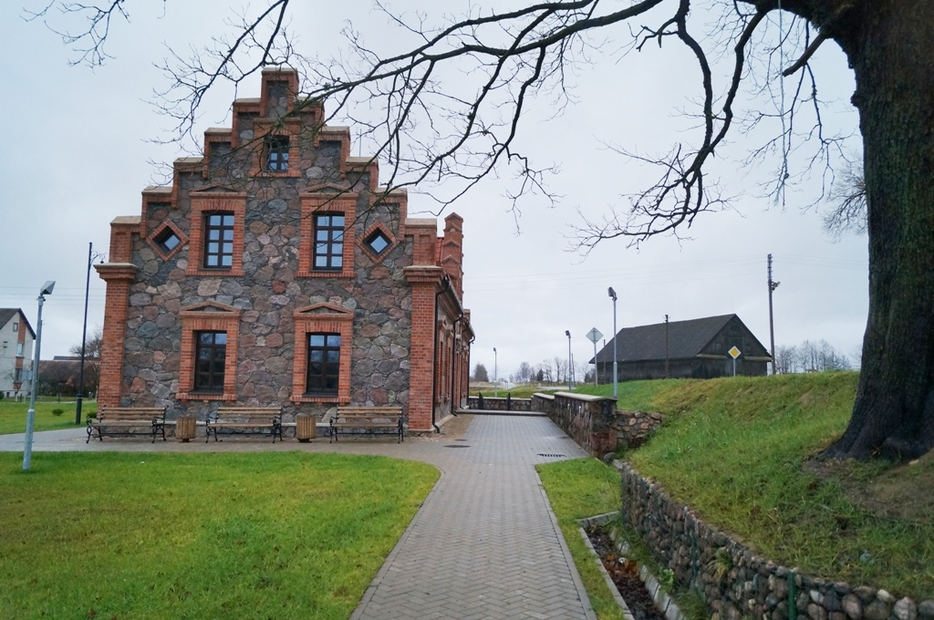

Slide 4
The church of St Matthew the Apostle and Evangelist near the square is the most beautiful Neo-Gothic ensemble in Lithuania.

Slide 5
The Independence Square of the town, formed at the end of the 18th–beginning of the 19th century, is now a priceless architectural value, which is of particular interest to tourists.

Slide 6
Rokiskis town is famous for its unique festivals of professional theatre, international festivals of organists, international workshops of painting shutters.

Slide 7
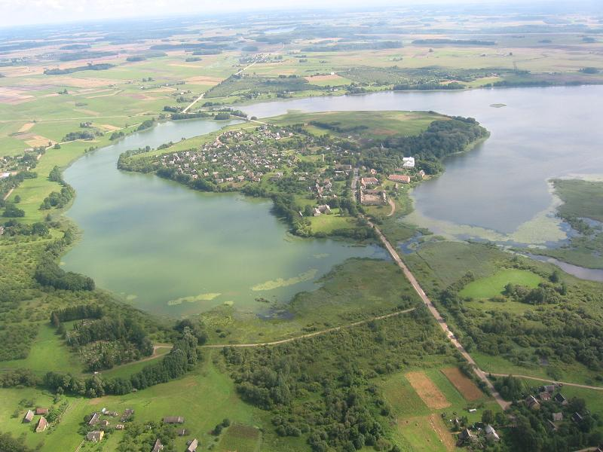
Enjoy your time in Rokiskis!

