Slide 1
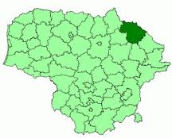
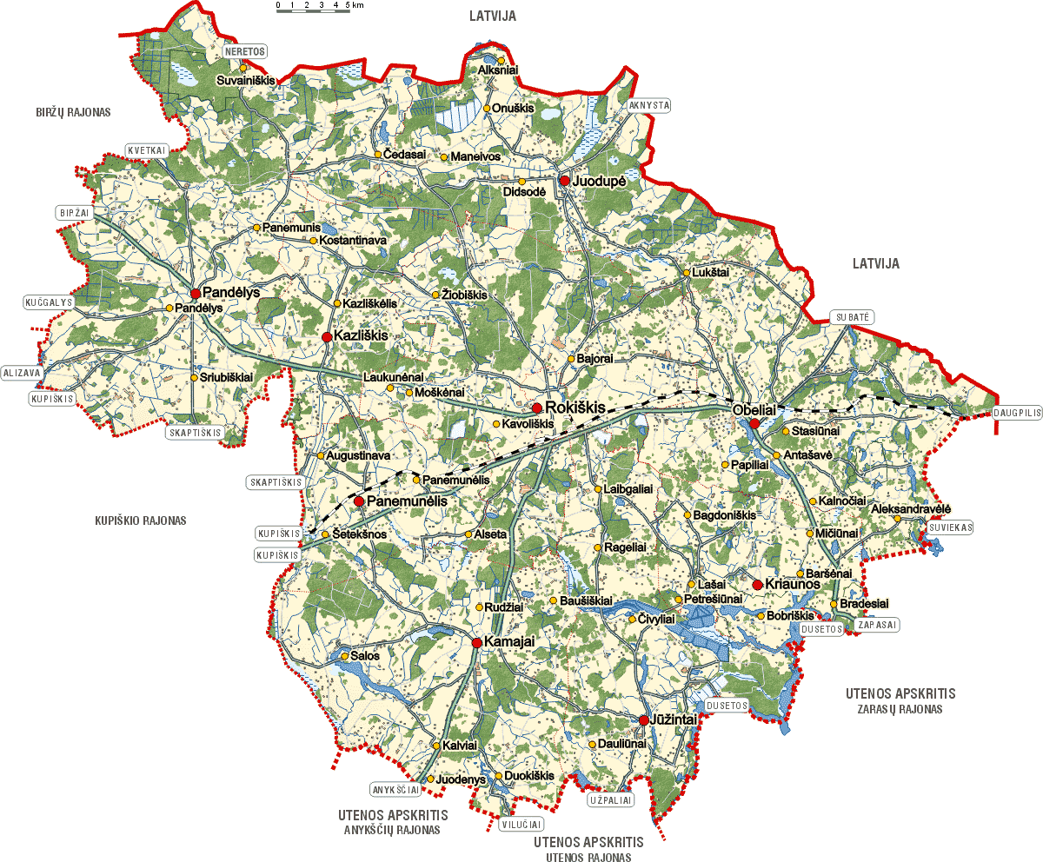
Geographical situation
Rokiskis region is located in the north-eastern part of Panevezys county, at the border with Latvia, on the Aukstaiciai Plateau. It is bordered by Birzai, Utena, Zarasai, Kupisklis and Anyksciai regions..
The district is crossed by a railway from Daugavpils to Siauliai, Panevezys and Kaunas. The distance to Vilnius is 180 km, to Kaunas – 175 km, to Ryga – 160 km and to Klaipeda – 360 km.

